Slide 1
Project 1: Energy, Emissions and Development
DATA 201 - Spring 2026
Raul Miranda

Slide 2
Motivation
Energy use is an indicator of technological, economic, social, development.
Combustion of fossil sources has led to increasing CO2 emissions.
QUESTIONS:
1- Is CO2 emission quantitatively correlated with the technological and economic development of nations over the past 30 years?
2. Have different regions of the world developed independent correlations?
3. Is the use of renewable energy evidenced by a reduction in CO2 production?
4. Is methane emission following similar trends to CO2?

Slide 3
Datasets
Our World in Data: CO2 and methane emissions, share of emissions from the various sources. https://github.com/owid/co2-data
World Bank - Patent applications as measure of technological advancement. https://data.worldbank.org/indicator/IP.PAT.RESD
Bias: sparse information for the less developed or more restrictive countries. 1990-2022 has a reasonable overlap of emissions and patent data for many countries.
Merged working dataset after cleaning:
7,194 rows and 82 columns - Countries: 218 - Years: 1990 to 2022

Slide 4
Variables of interest
Variable Definition Type
country Name of the country Categorical
continent Name of continent Categorical
year Calendar year of observation Quantitative
iso_code ISO 3-letter country code Categorical
population Total population Quantitative
gdp Gross domestic product (constant 2011 USD) Quantitative
co2 Annual CO2 emissions (million tonnes) Quantitative
methane Annual methane emissions (MtCO2e) Quantitative
primary_energy_consumption Total primary energy (TWh) Quantitative
patent_applications Resident patent filings (WIPO) Quantitative
co2_per_unit_energy Renewable energy proxy (kg CO2/kWh) Quantitative

Slide 5
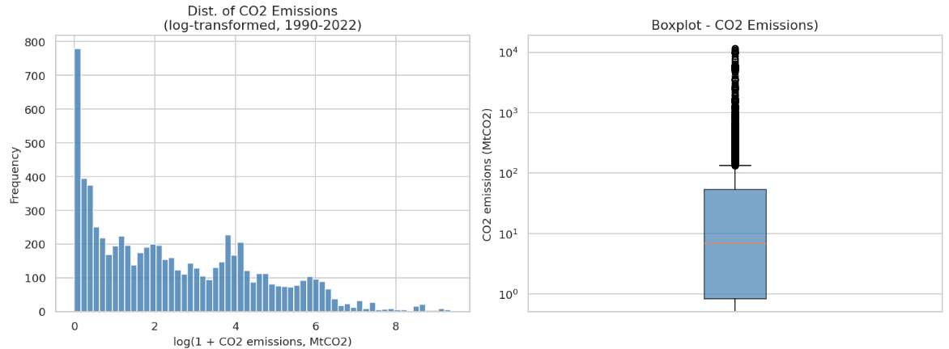
Analysis: Annual CO2 Emissions
Question: What is the distribution of annual CO2 emissions (in million tonnes) across country-years from 1990 to 2022, and what does that distribution reveal about global inequality in emissions?
Mean : 135.39 MtCO2
Median : 6.88 MtCO2
Std Dev: 656.52 MtCO2

Slide 6
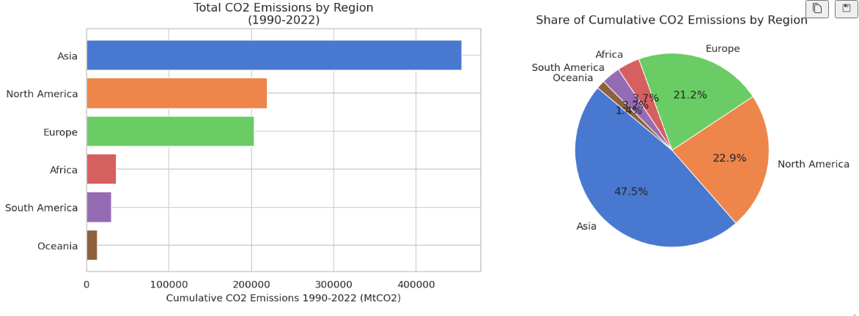
Analysis: Continent
Question: How are total CO2 emissions distributed across continents, and which ones contribute most to global emissions over 1990-2022?

Slide 7
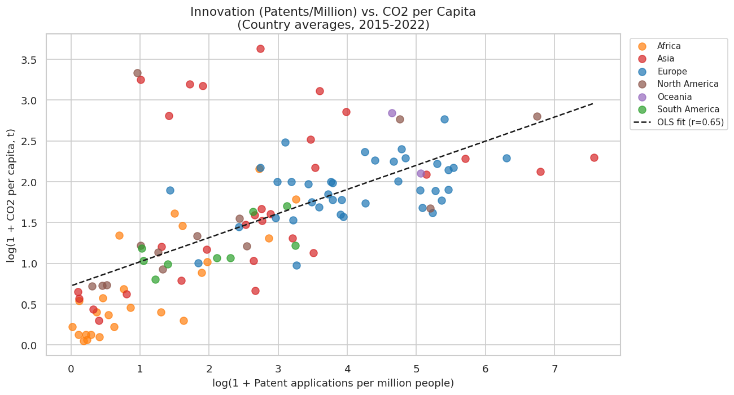
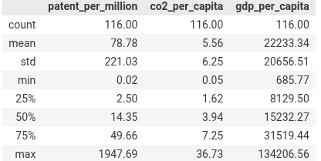
Relationship between Patents and CO2 Emissions
(using 2015-2020 average)
Question: Is there a relationship between a country's technological innovation (resident patent filings per million people) and its annual CO2 emissions per capita? Does higher innovation correlate with lower or higher emissions intensity?*
Pearson r (log-log): 0.648

Slide 8
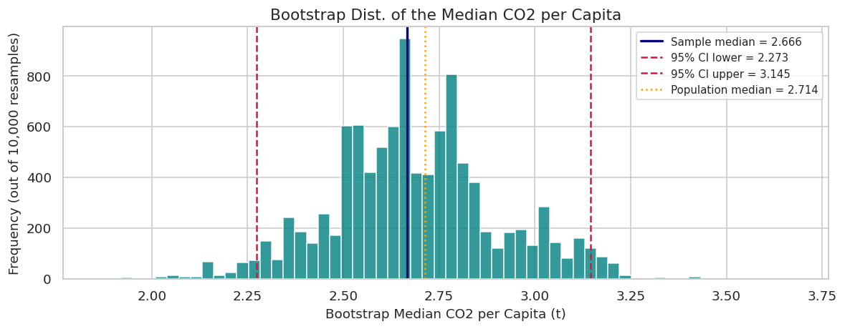
Nonparametric inference - bootstrap CI for median CO2/capita
Question: What is the median CO2 per capita among all country-years from 1990-2022, and how precisely can we estimate it from a 10% random sample?
Full population size N = 7,016
Population median = 2.7137 t CO2/person
Sample size n = 702 (10.0%)
Sample median = 2.6660 t CO2/person
Bootstrap SE of median= 0.2160
95% CI (percentile method)=
[2.2734, 3.1448] t CO2/person
Interval width: 0.8714

Slide 9
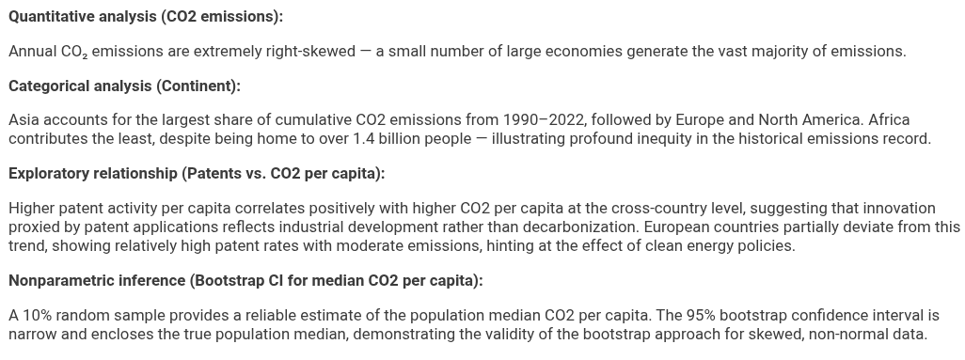
Conclusions

